Slide 1
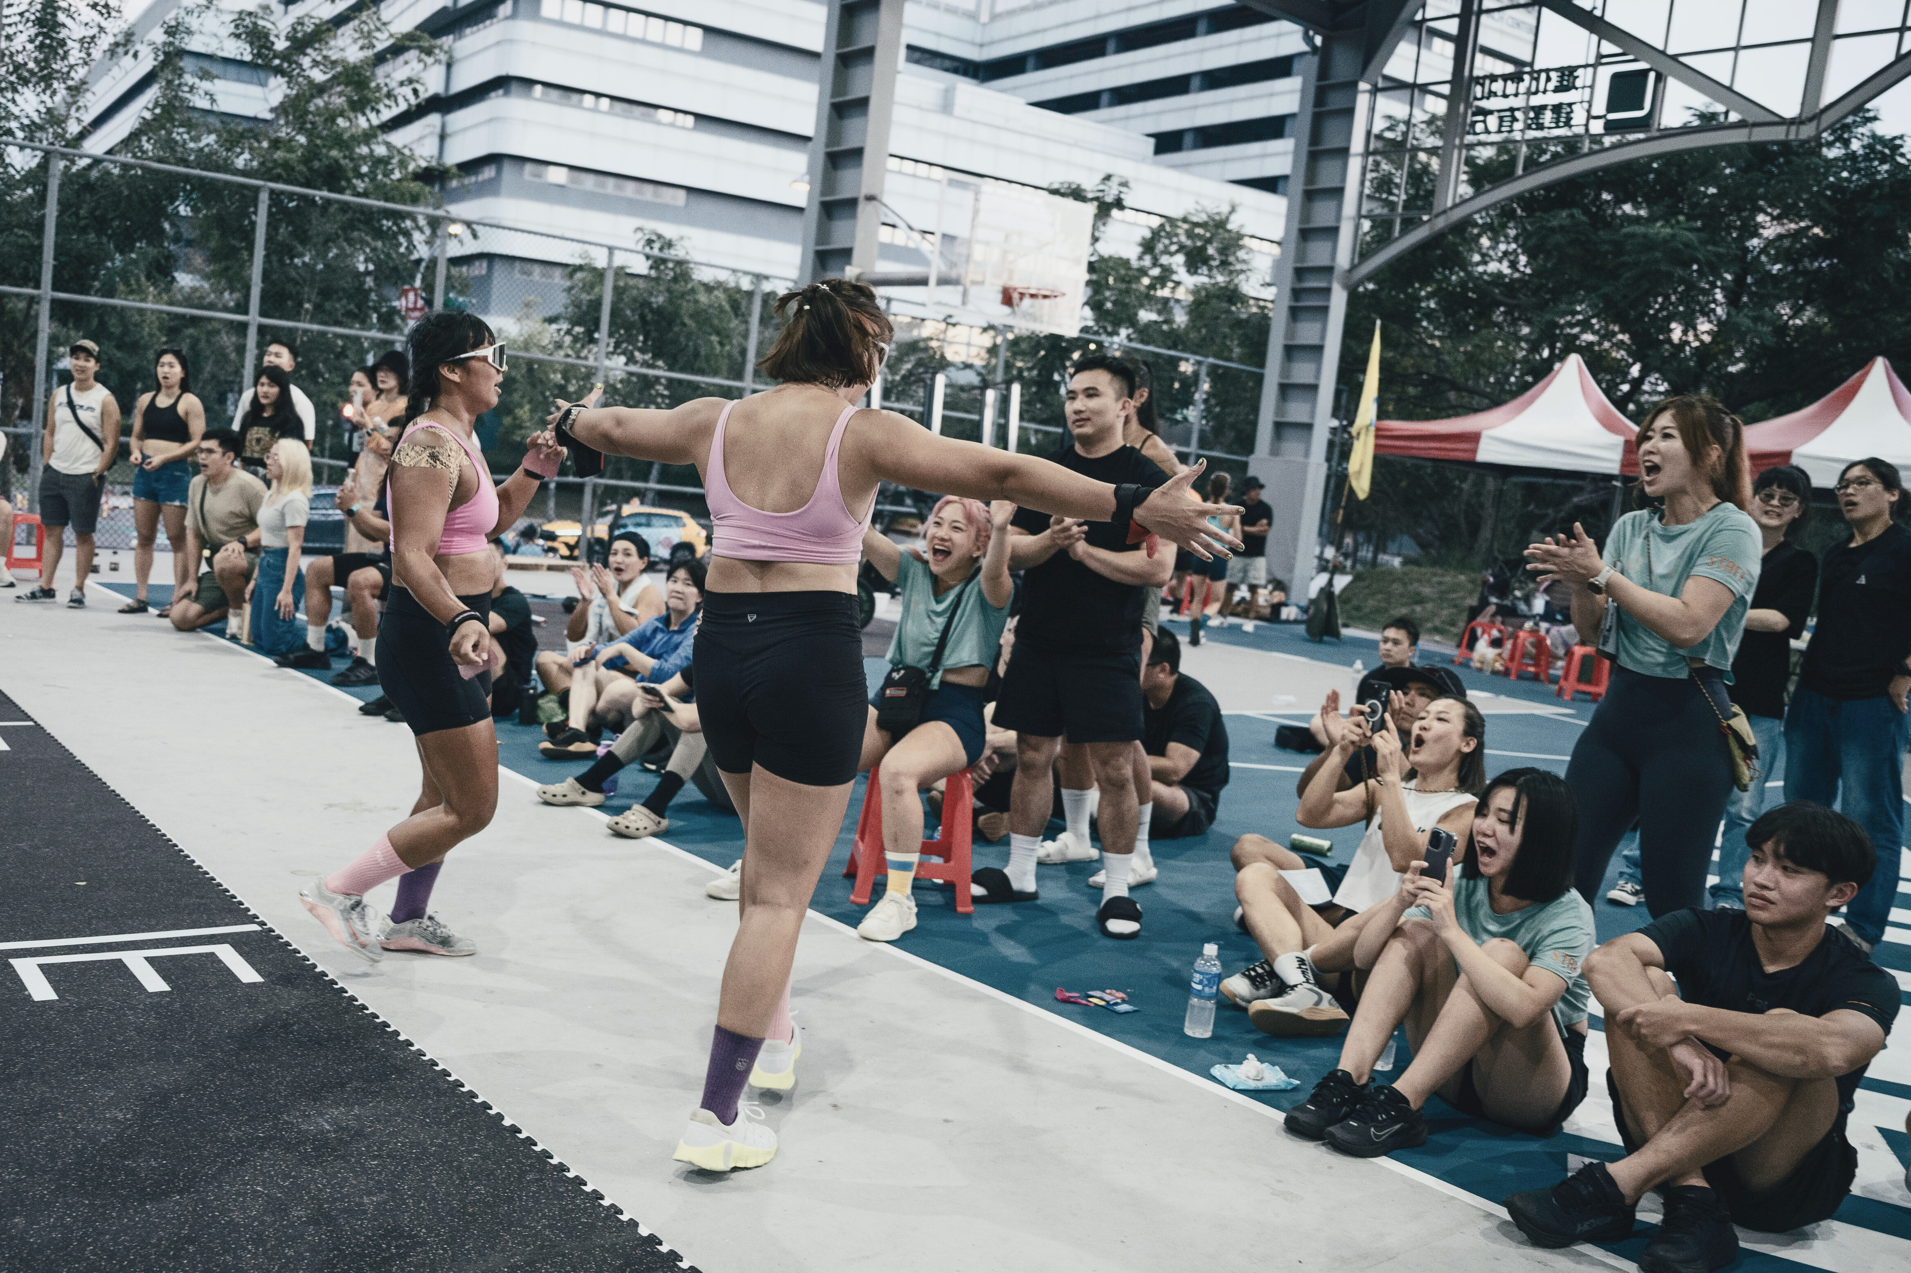



EST.2018
Presented by
Kevin

Slide 2
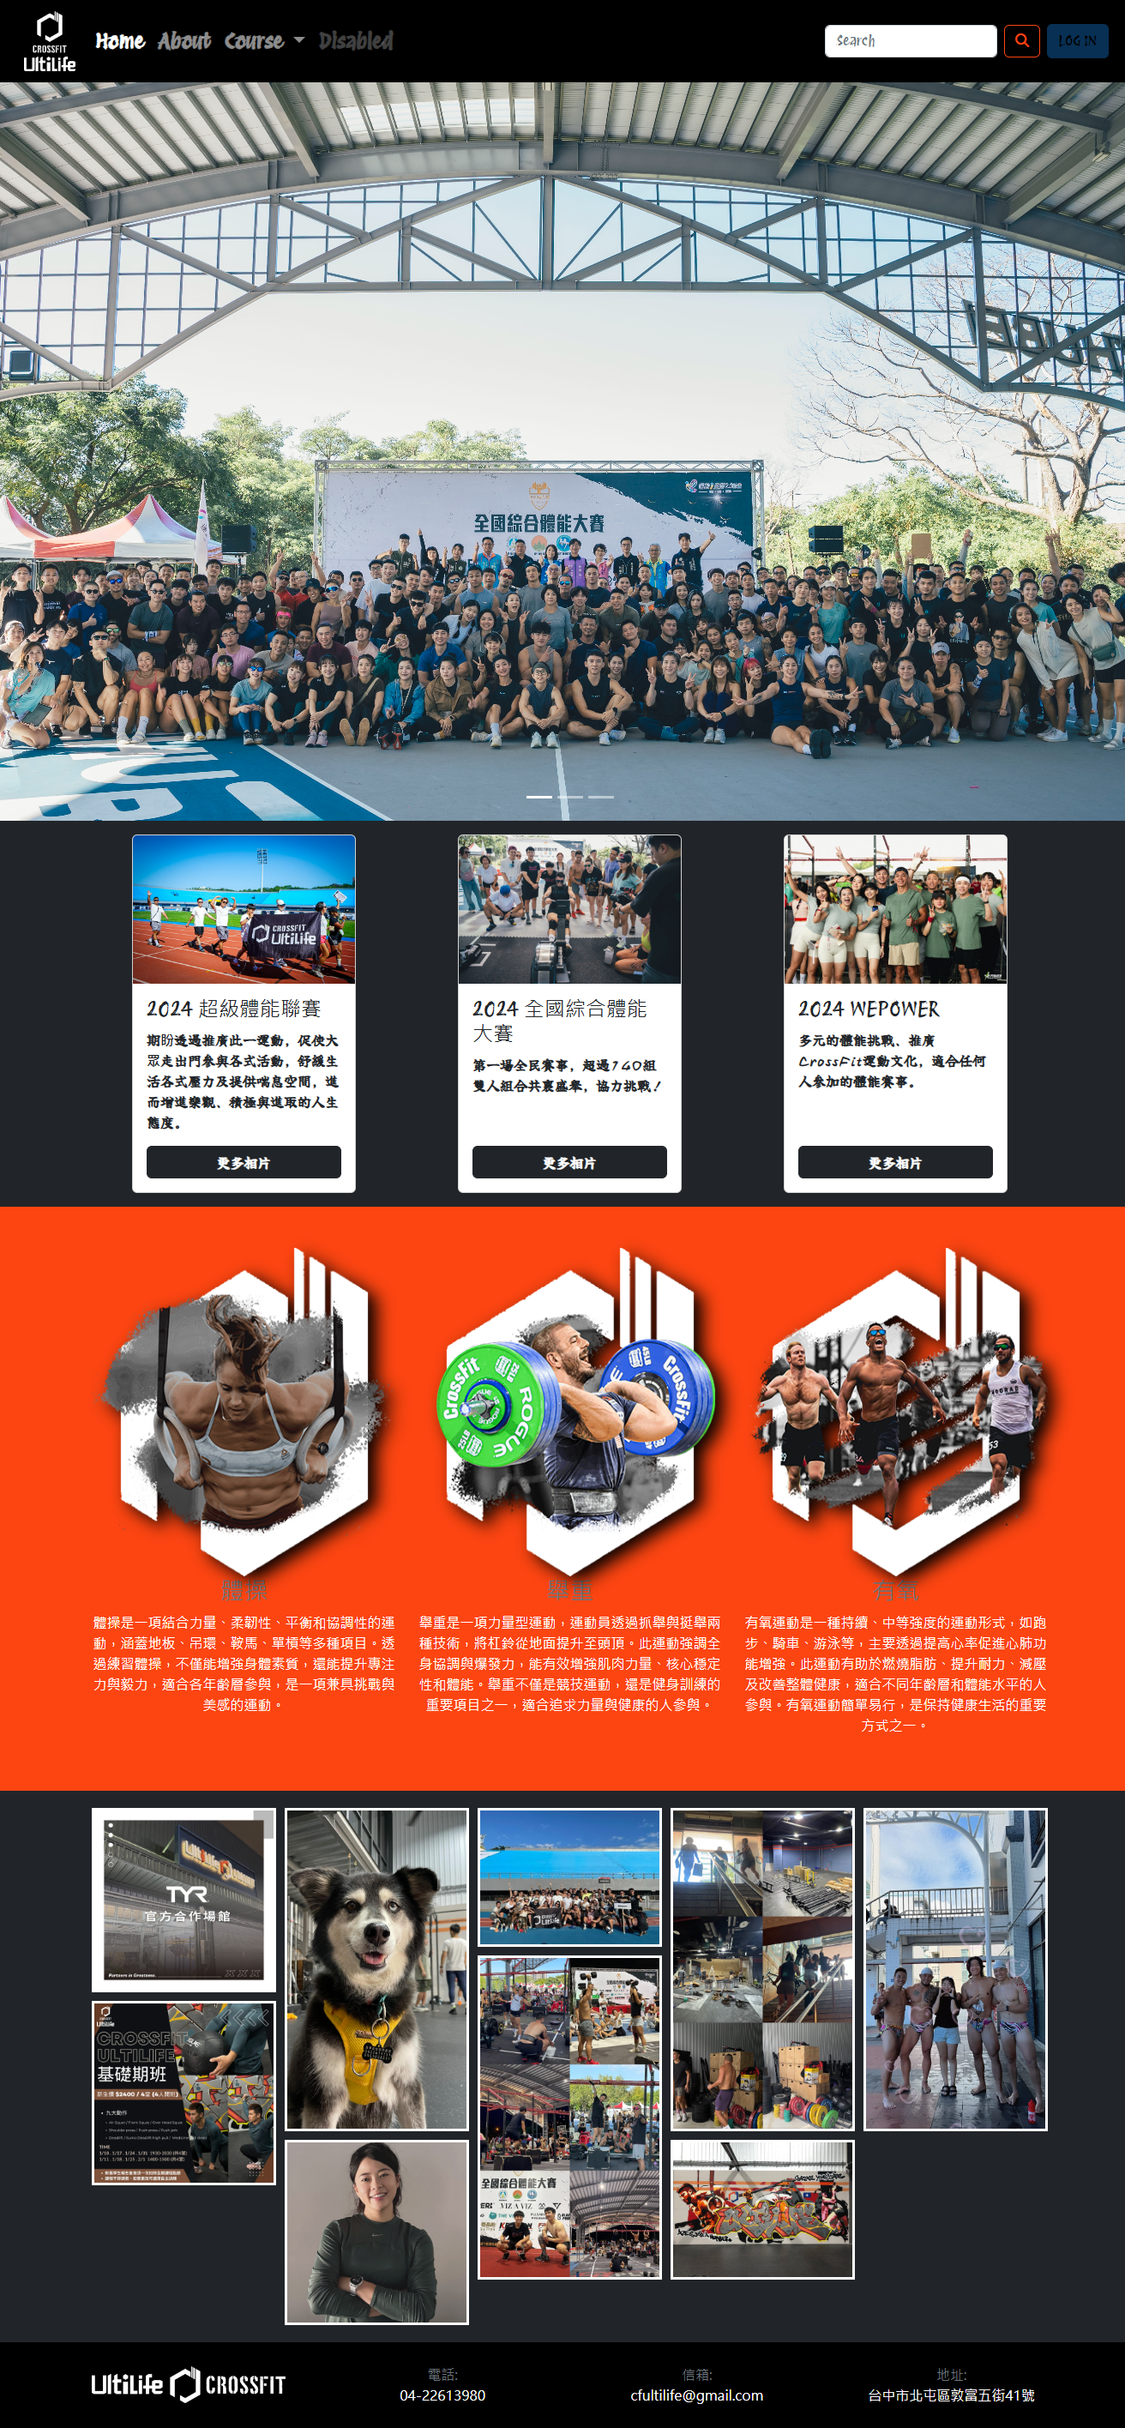

Introduction
ULTILIFE CROSSFIT
官網製作
健身房創立於2018年，以專業的教練團隊與會員建立起深厚的信任與友好關係，打造出積極且和諧的健身氛圍。我們希望透過專屬官網，讓更多台中的朋友認識我們，一同加入健康生活的行列，實現您的健身目標！

Slide 3
主要課程
CROSSFIT,
體操,舉重,
有氧
體操
舉重
注重核心穩定性與身體控制，如引體向上、倒立與人體旗幟，幫助改善柔韌性、平衡感及協調性。
專注於力量與爆發力的提升，包括硬舉、深蹲和推舉等動作，有助於強化全身肌群和提升運動表現。
有氧
CROSSFIT
強化心肺耐力的訓練，如划船、跳繩和跑步，增進代謝功能並提高運動持久力。
將舉重、體操和有氧運動相結合，它以多樣化的課程和挑戰性強的訓練，幫助參與者全面強化力量、耐力、速度和靈活性，是追求全面健康的理想選擇。

Slide 4
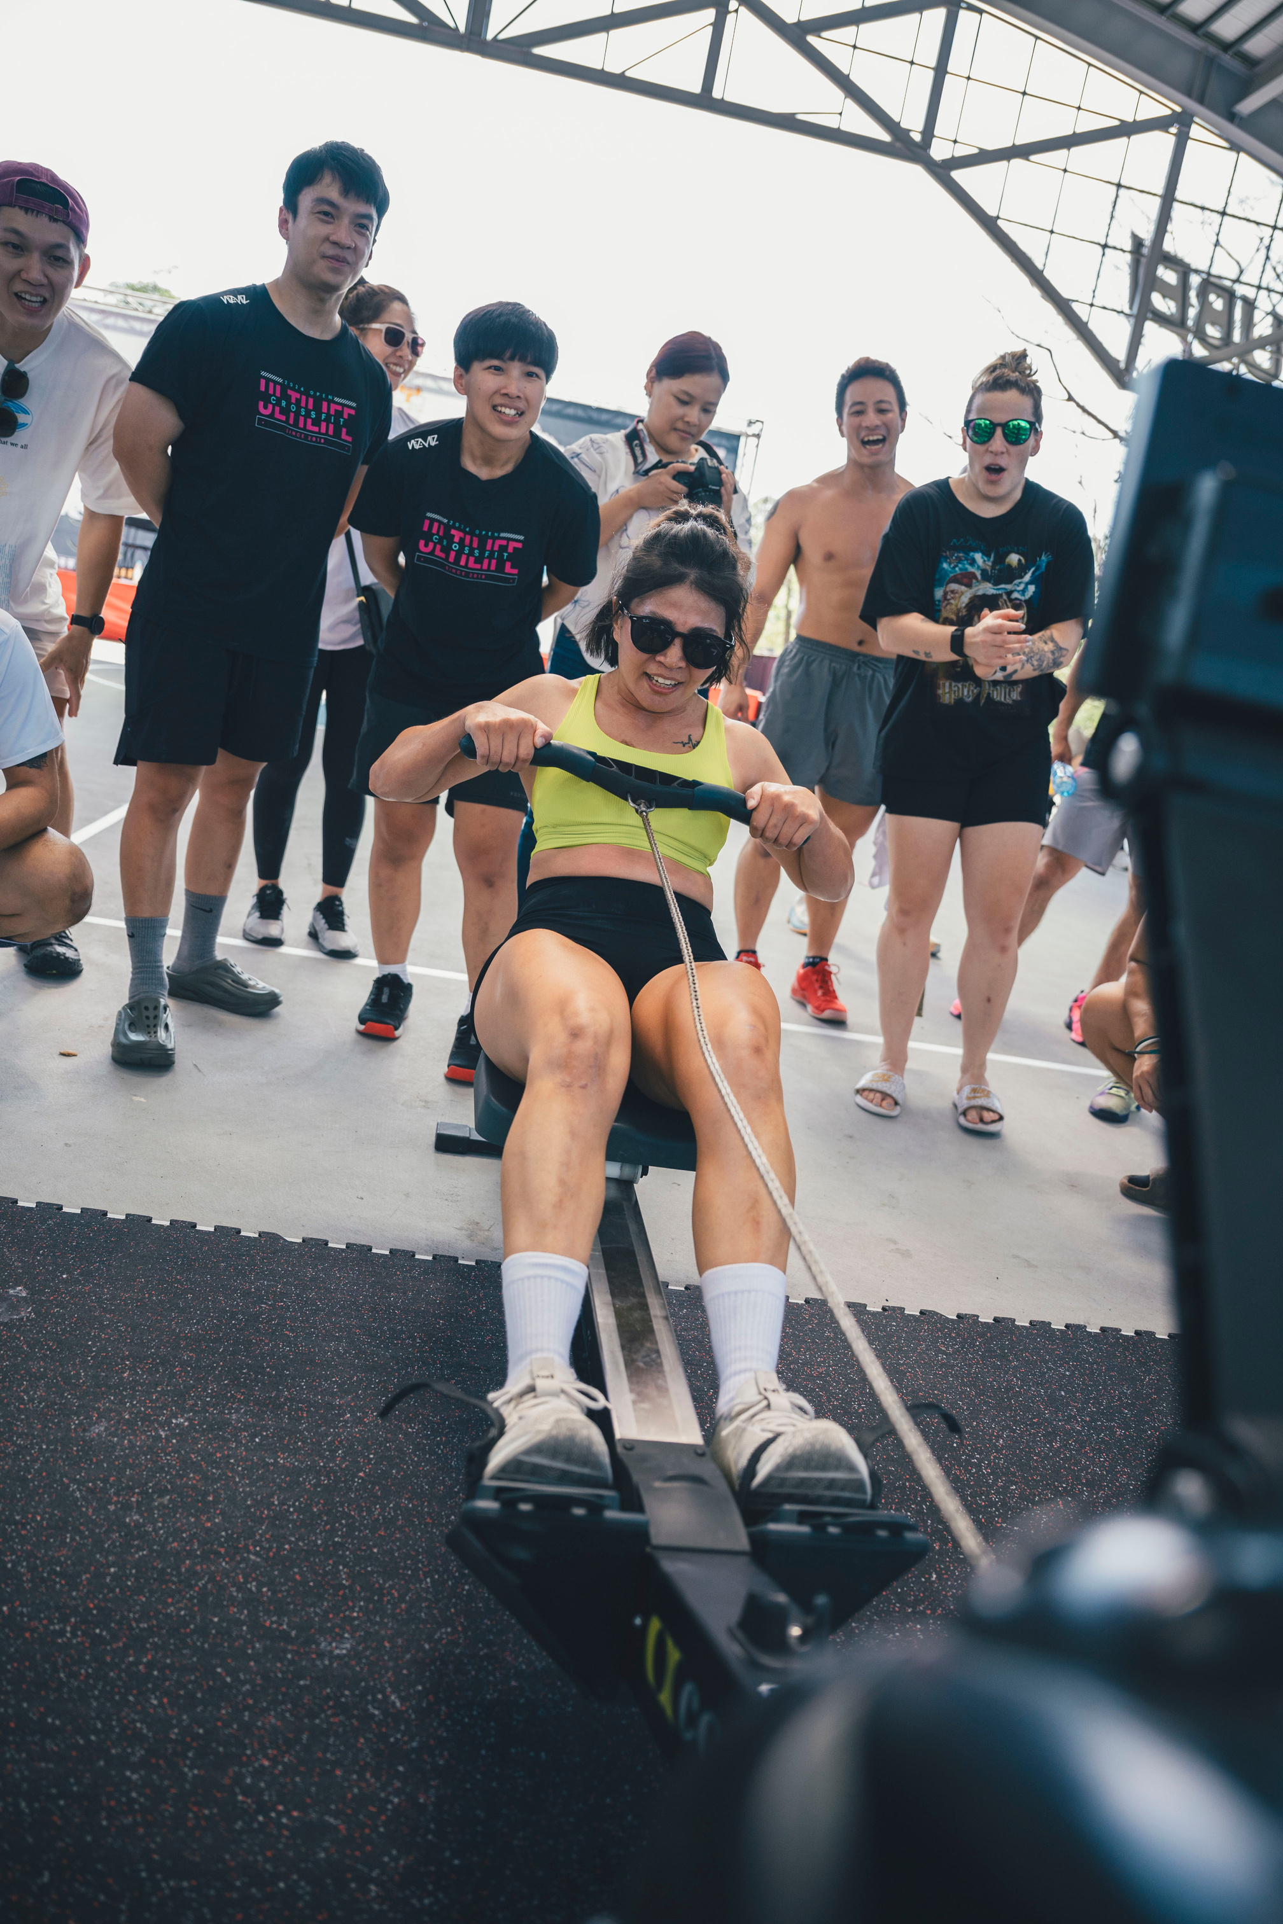
社群魅力
凝聚力 氛圍
激發動力、創造歸屬感與增強訓練效果
每堂課都像一個小型社群，參與者彼此鼓勵、分享進步與挑戰。教練與會員間建立深厚連結，而共同完成高強度訓練的過程，激發團隊精神，讓每個人都能在彼此的支持下突破自我，成為更好的自己。這種強大的社群感受，讓CrossFit不僅是一種運動，更是一種生活方式。
官網首頁設置了連結Instagram貼文的功能，實時展示我們的最新動態與活動內容。透過這個功能，訪客可以直接瀏覽我們在Instagram上分享的課程花絮、會員訓練成果、社群活動與健身技巧等貼文，不僅拉近我們與用戶的距離，也讓官網保持動態更新，展現健身房的活力與魅力。此外，點擊貼文後可直接跳轉至官方Instagram帳號，方便用戶追蹤並參與更多互動。這功能融合視覺吸引力與社群連結，有效提升官網的吸引力與用戶體驗。

Slide 5
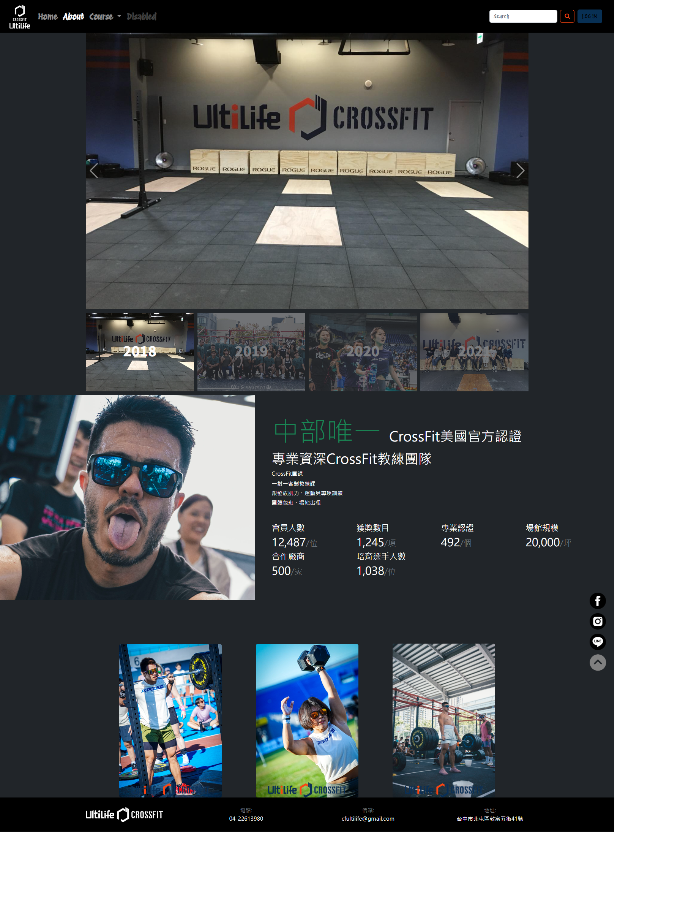
Health and Wellness
The Power of Sports for a Healthy Lifestyle
歷史回顧
教練介紹
The role of athletic games in promoting cardiovascular health, strength, and flexibility. Combatting sedentary lifestyles through regular physical activity.
Stress reduction, improved mood, and enhanced cognitive function through sports. The holistic impact on mental health and well-being.
Explore the transformative power of athletic games in promoting a healthy lifestyle.

Slide 6
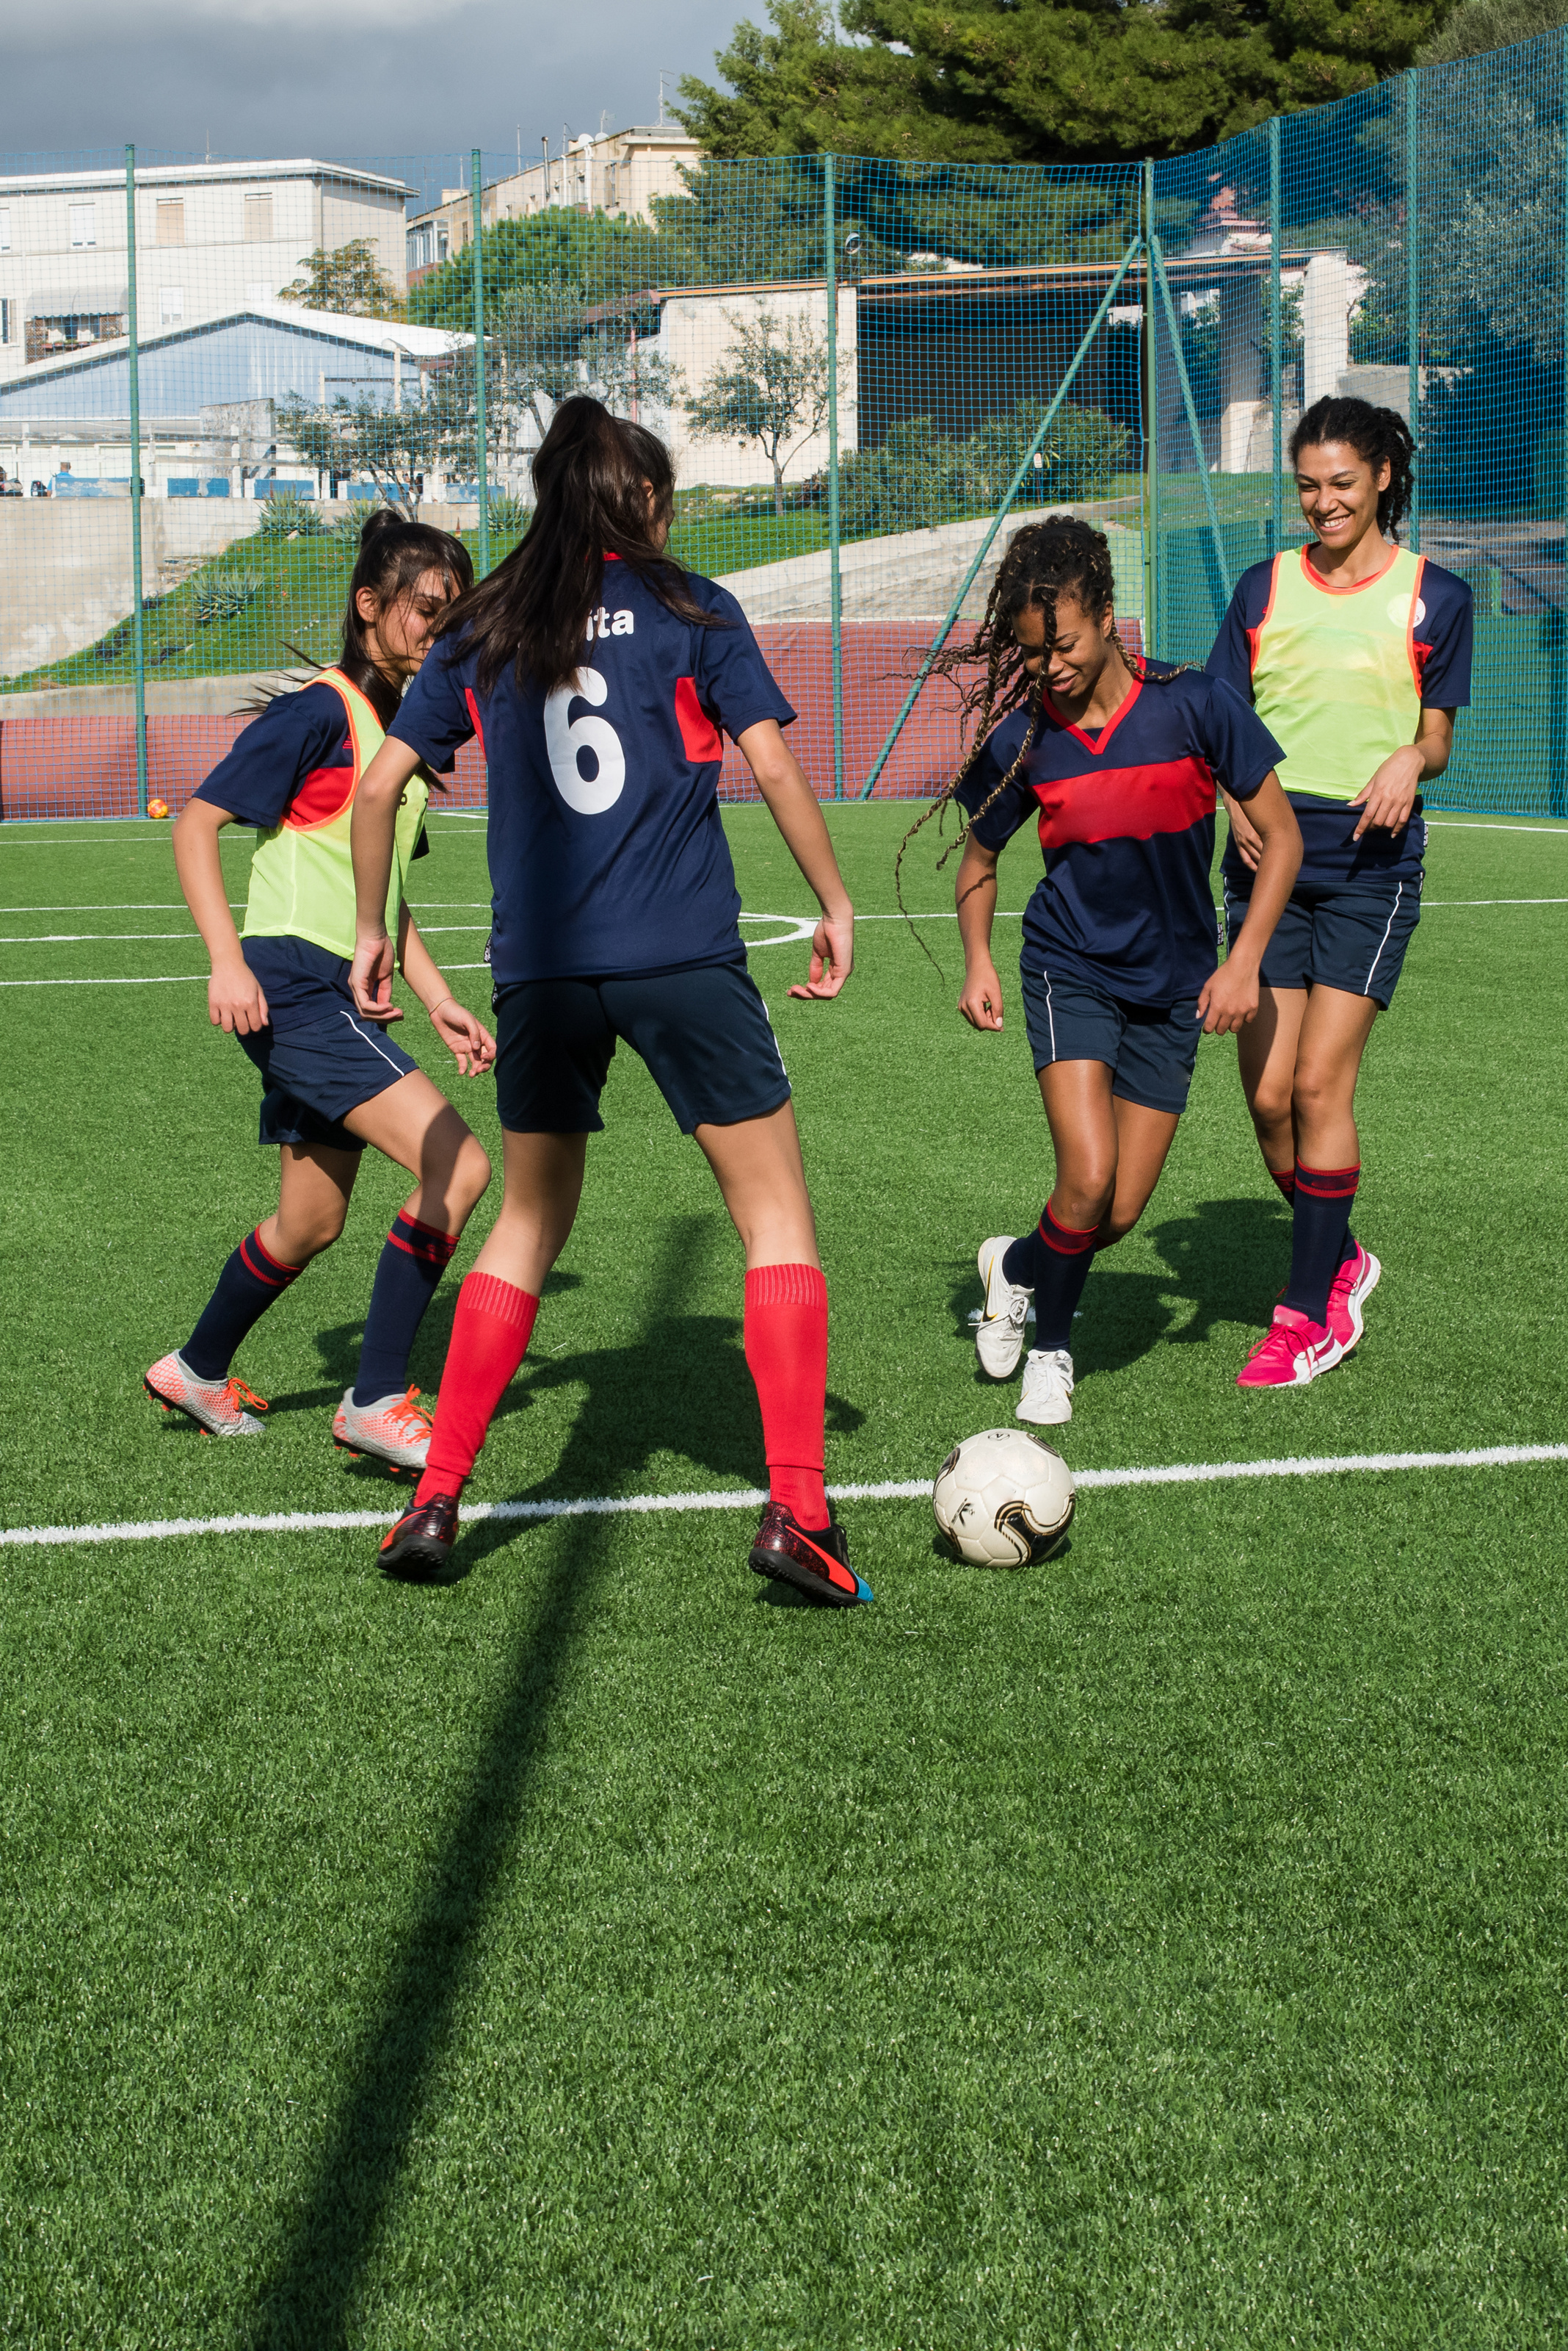
Category: Team Sports
Athletic Games Trivia Quiz
In football (soccer), what is the maximum number of players allowed on the field from one team during a match?
A. 11 Players
B. 12 Players
Fun Session
C. 13 Players

Slide 7
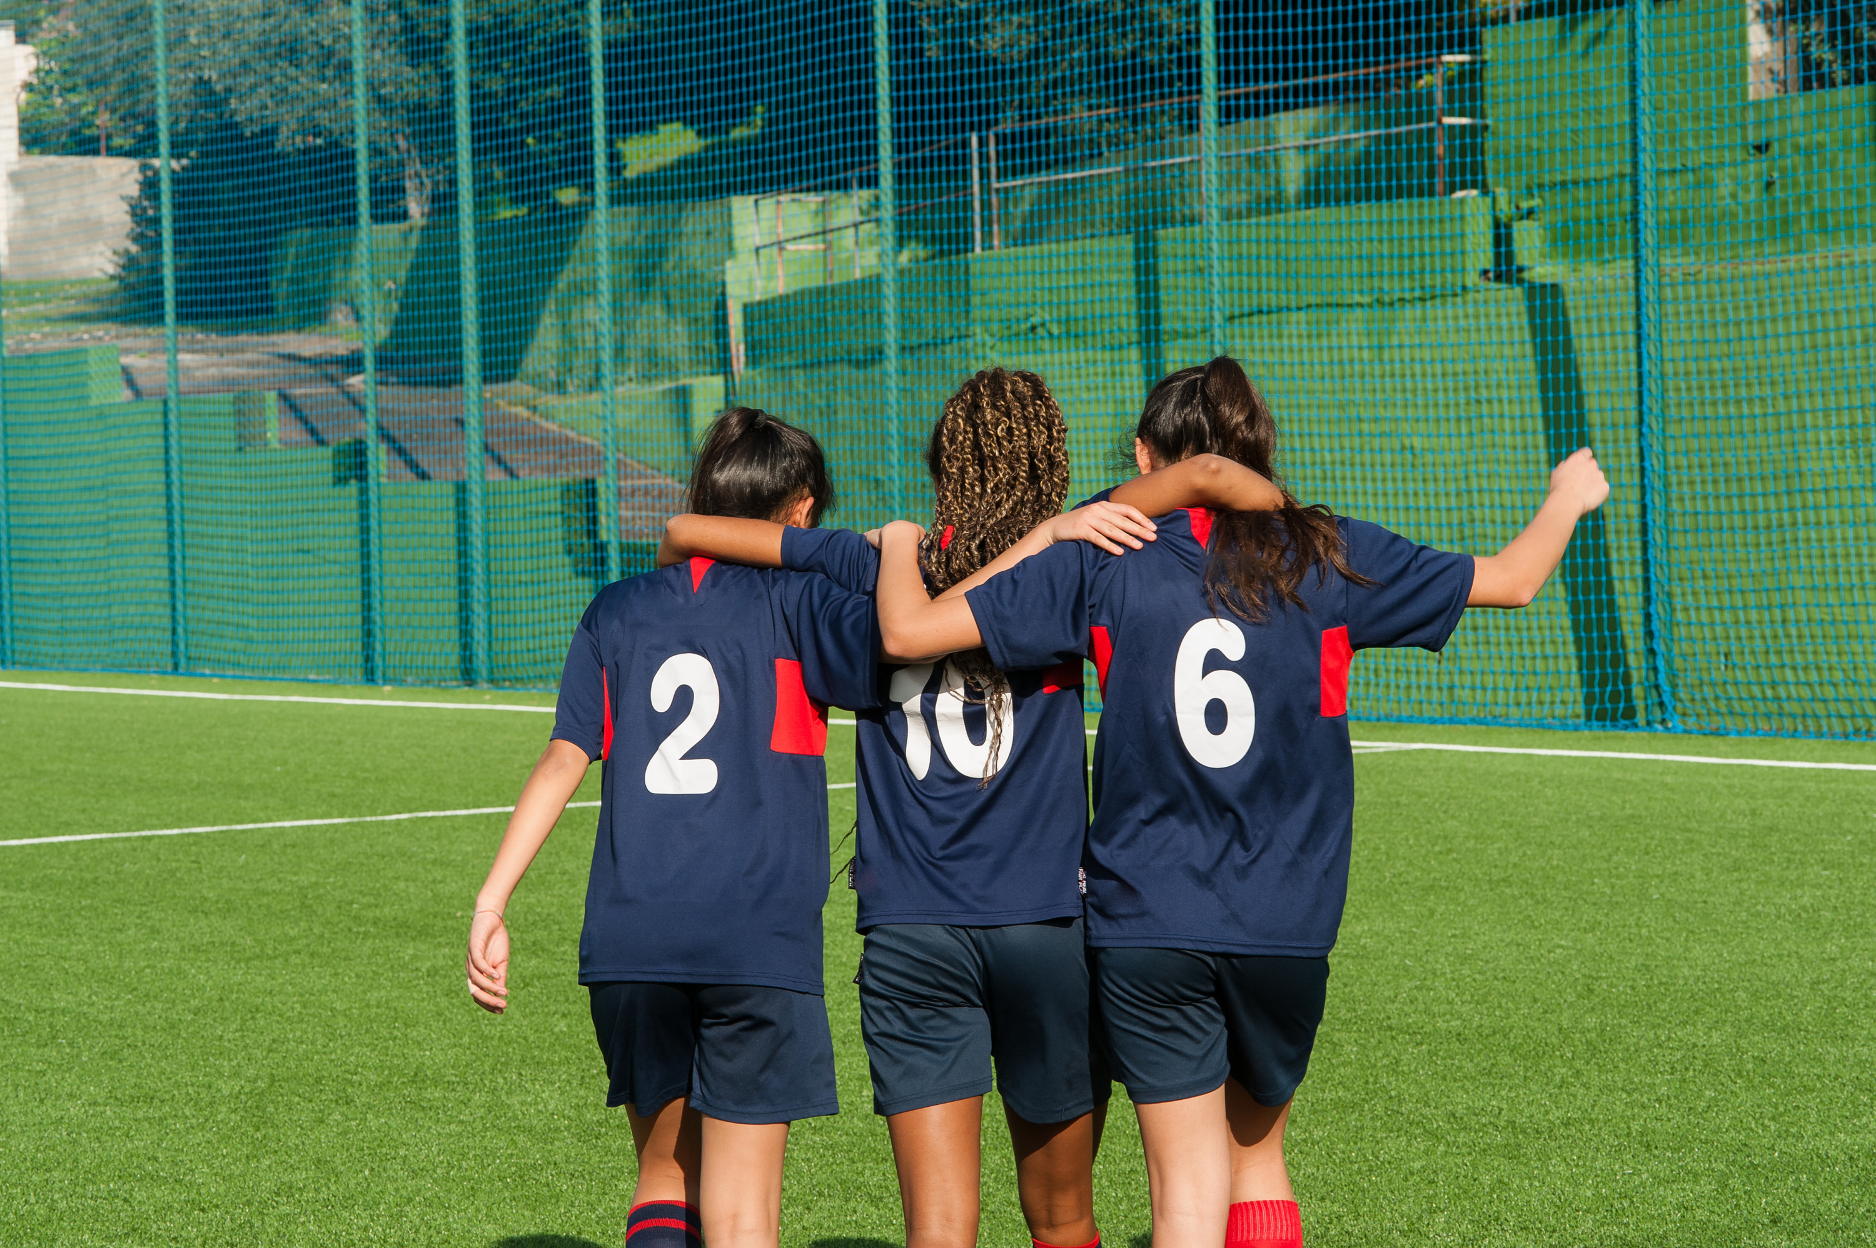
Category: Team Sports
The Answer is
Football teams have 11 players on the field because it allows for balanced and fair gameplay, supports various strategies.
A. 11 Players
B. 12 Players
Fun Session
C. 13 Players

Slide 8
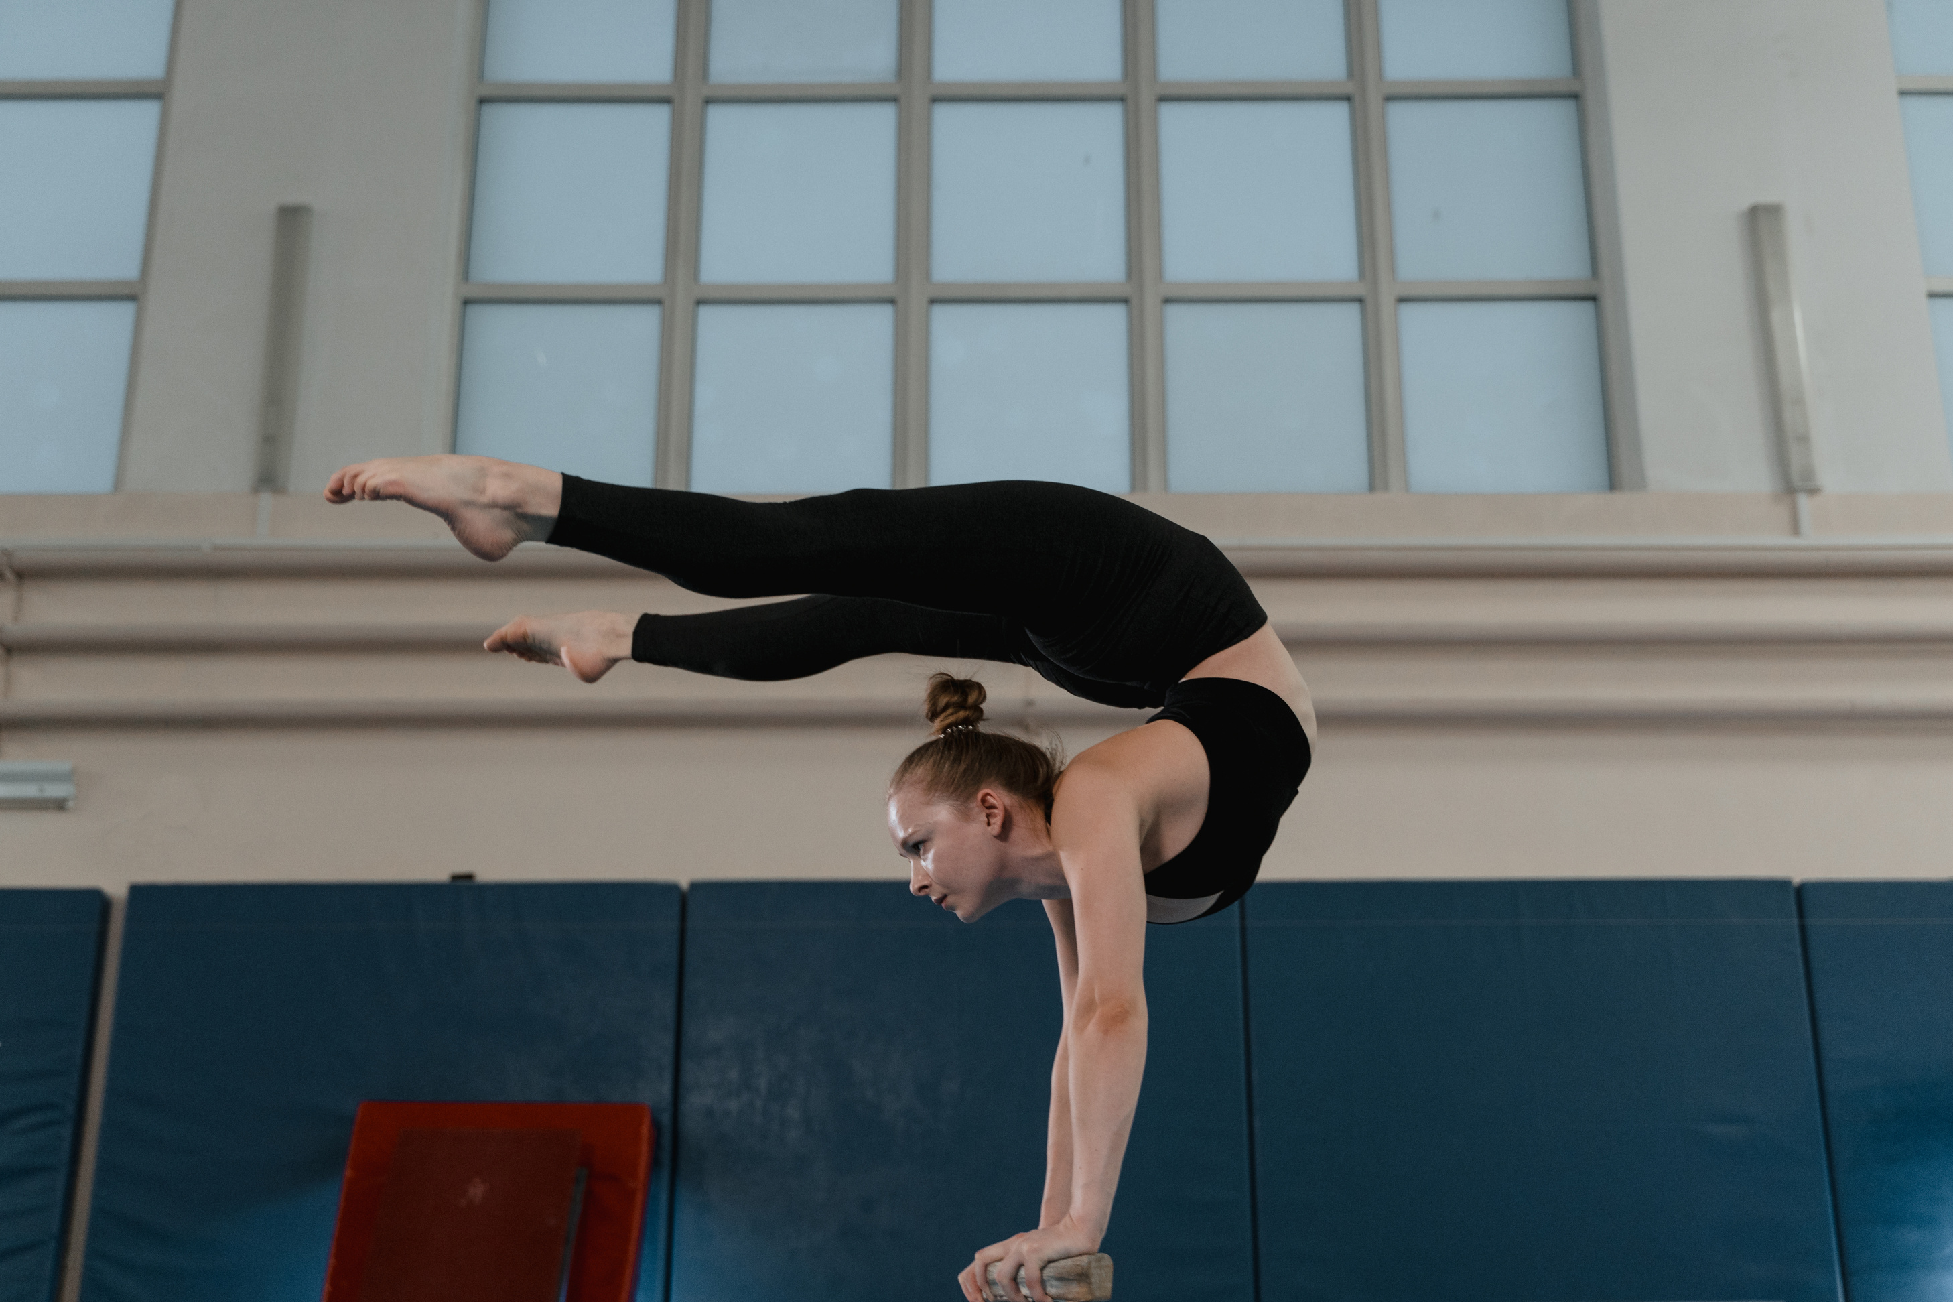
Category: Gymnastics
Athletic Games Trivia Quiz
What is the maximum score a gymnast can achieve in artistic gymnastics?
A. Maximum score is 25.0
B. Maximum score is 10.0
Fun Session
C. Maximum score is 12.0

Slide 9
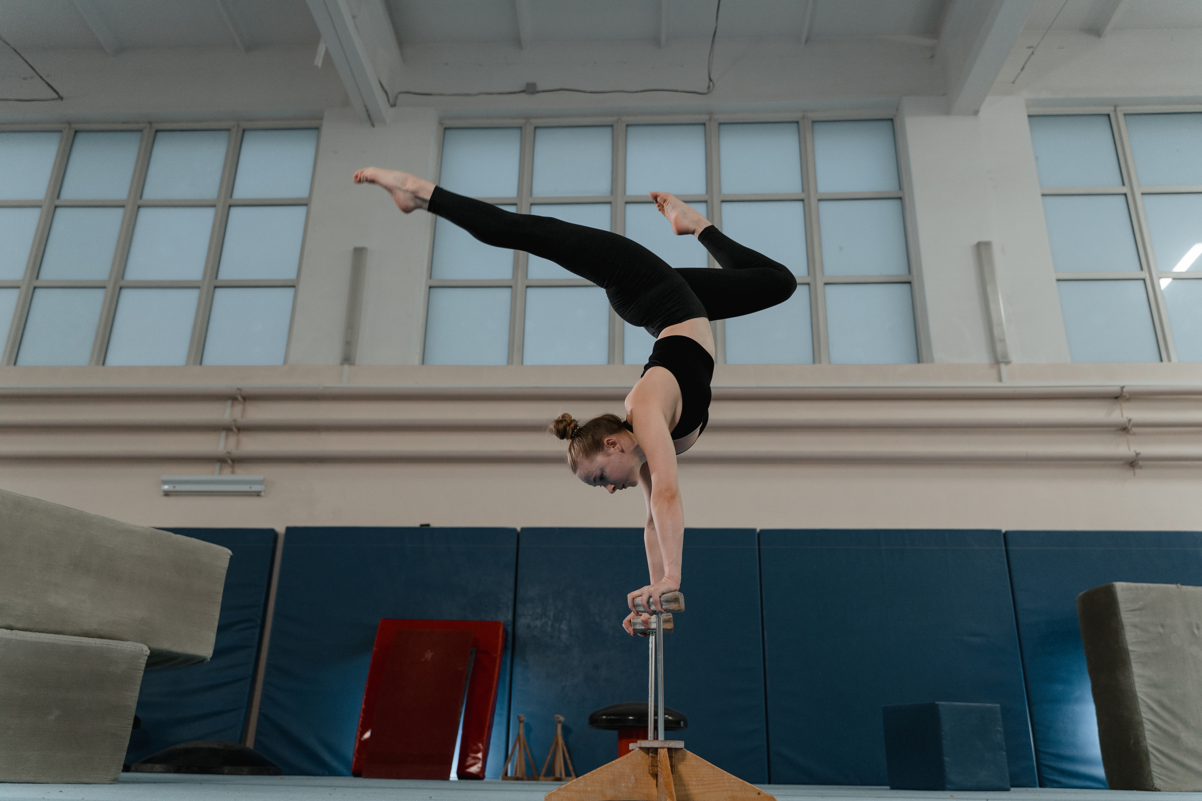
Category: Gymnastics
The Answer is
In artistic gymnastics, the maximum score a gymnast can achieve is 10.0, signifying a flawless and perfect routine.
A. Maximum score is 25.0
B. Maximum score is 10.0
Fun Session
C. Maximum score is 12.0

Slide 10
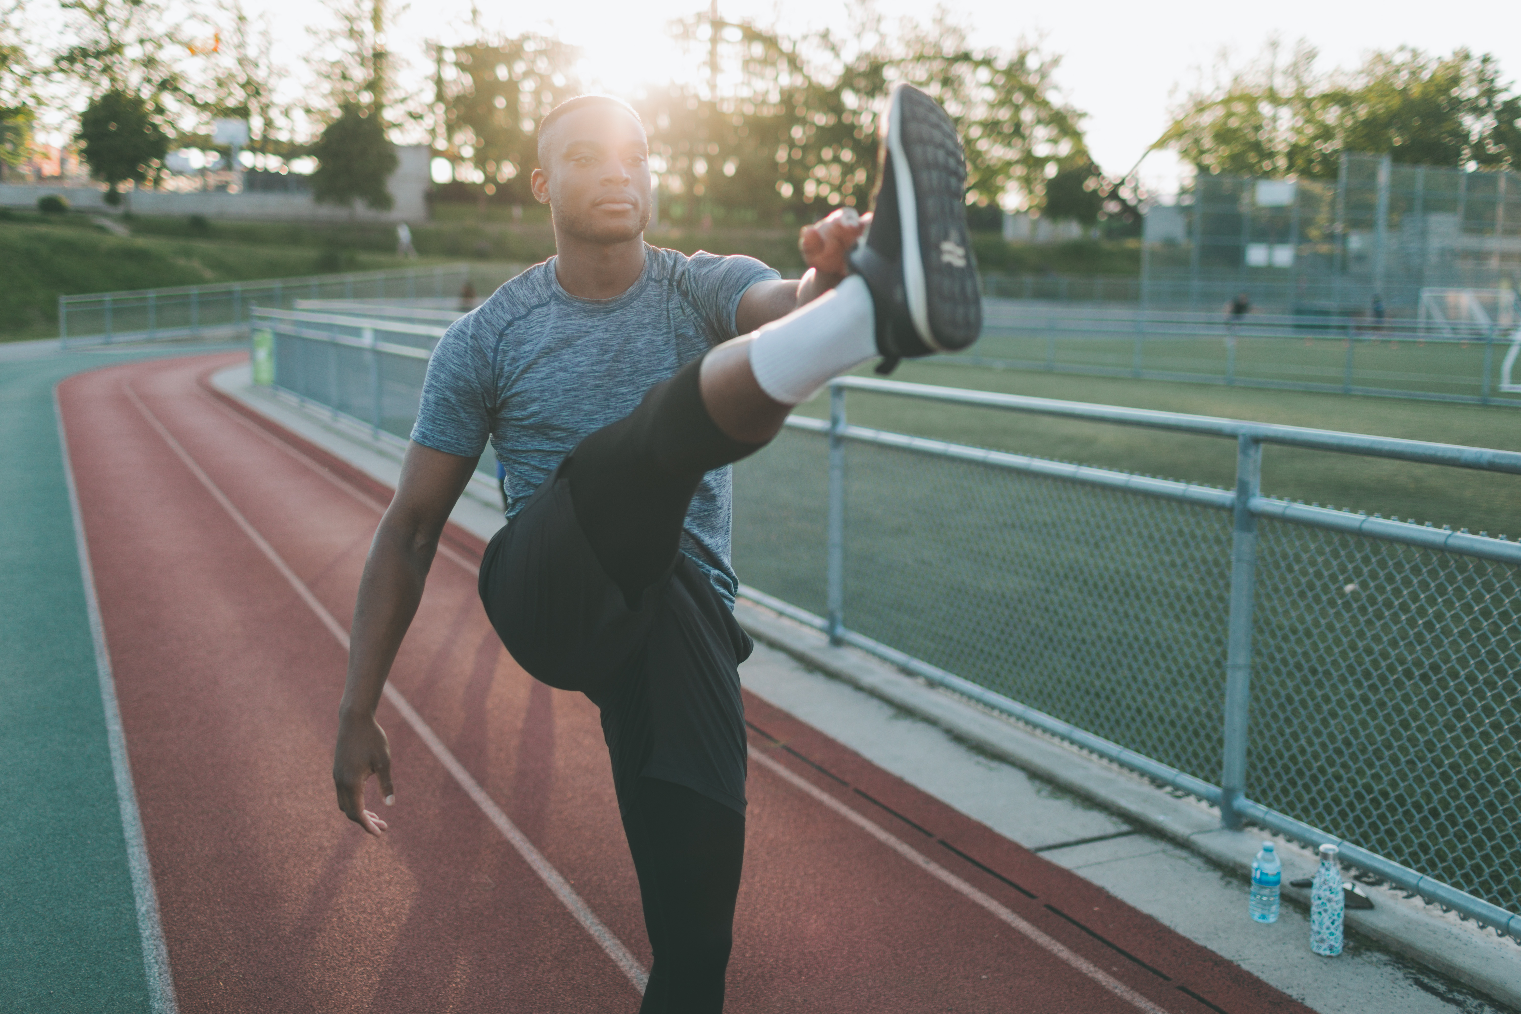
THANK YOU
Your Time and Attention Are Truly Appreciated
We extend our sincere gratitude for joining us on this exploration of athletic games. Your participation and engagement have made this journey memorable.
Thank you for celebrating the spirit of sports with us!
www.reallygreatsite.com

